Slide 1

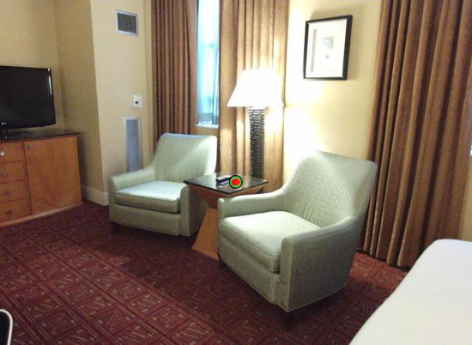
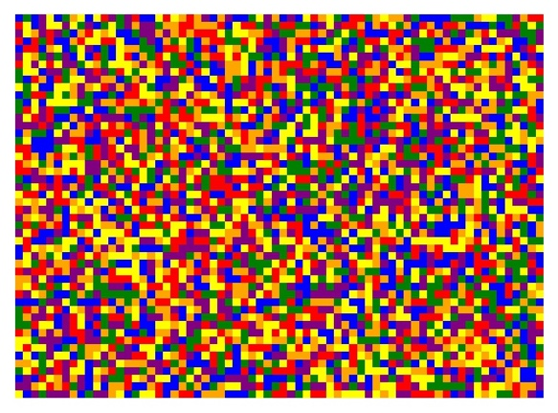
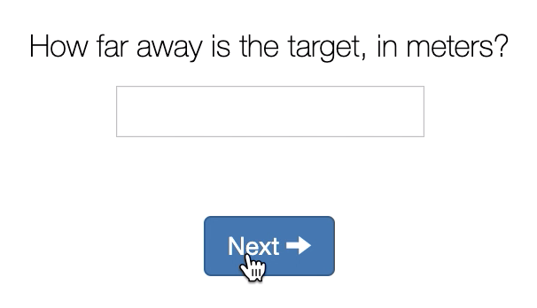

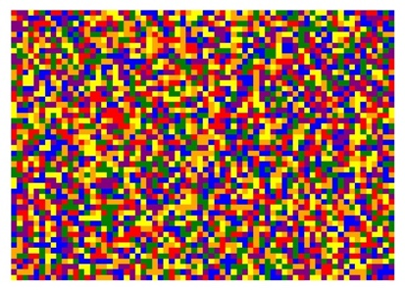
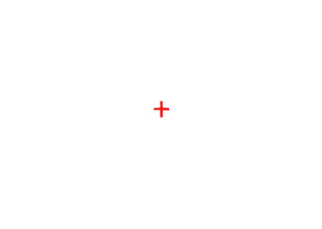
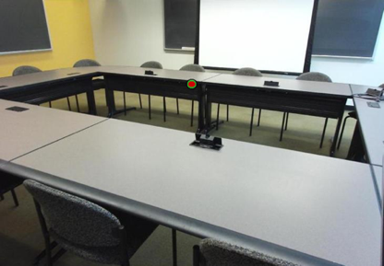

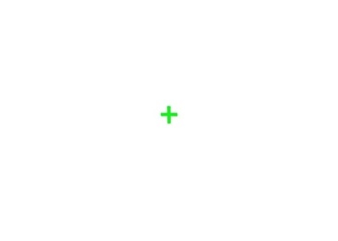
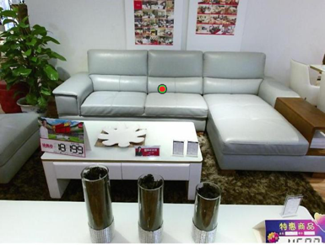
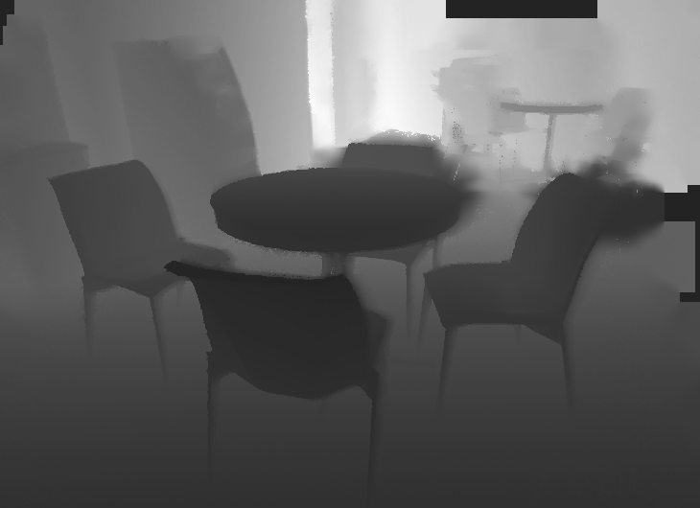

A.
B.
Target Image
125, 250, or 1000 ms
500 ms
time
500 ms
Respond which target was closer
C.
- 0.25 m
125, 250, or 1000 ms
500 ms
time
500 ms
500 ms
Kinectv2 Depth Image
- 2.6 m
125, 250, or 1000 ms
500 ms
500 ms
- 5 m
Figure 1. Behavioral Paradigms. A) Sample target image and corresponding SUN-RGBD depth map. B) Verbal estimate paradigm. Scenes with embedded targets were presented for a variable duration followed by a mask. C) Distance discrimination paradigm. Participants were presented with two scenes for the same duration and responded which target was closer.

Slide 2
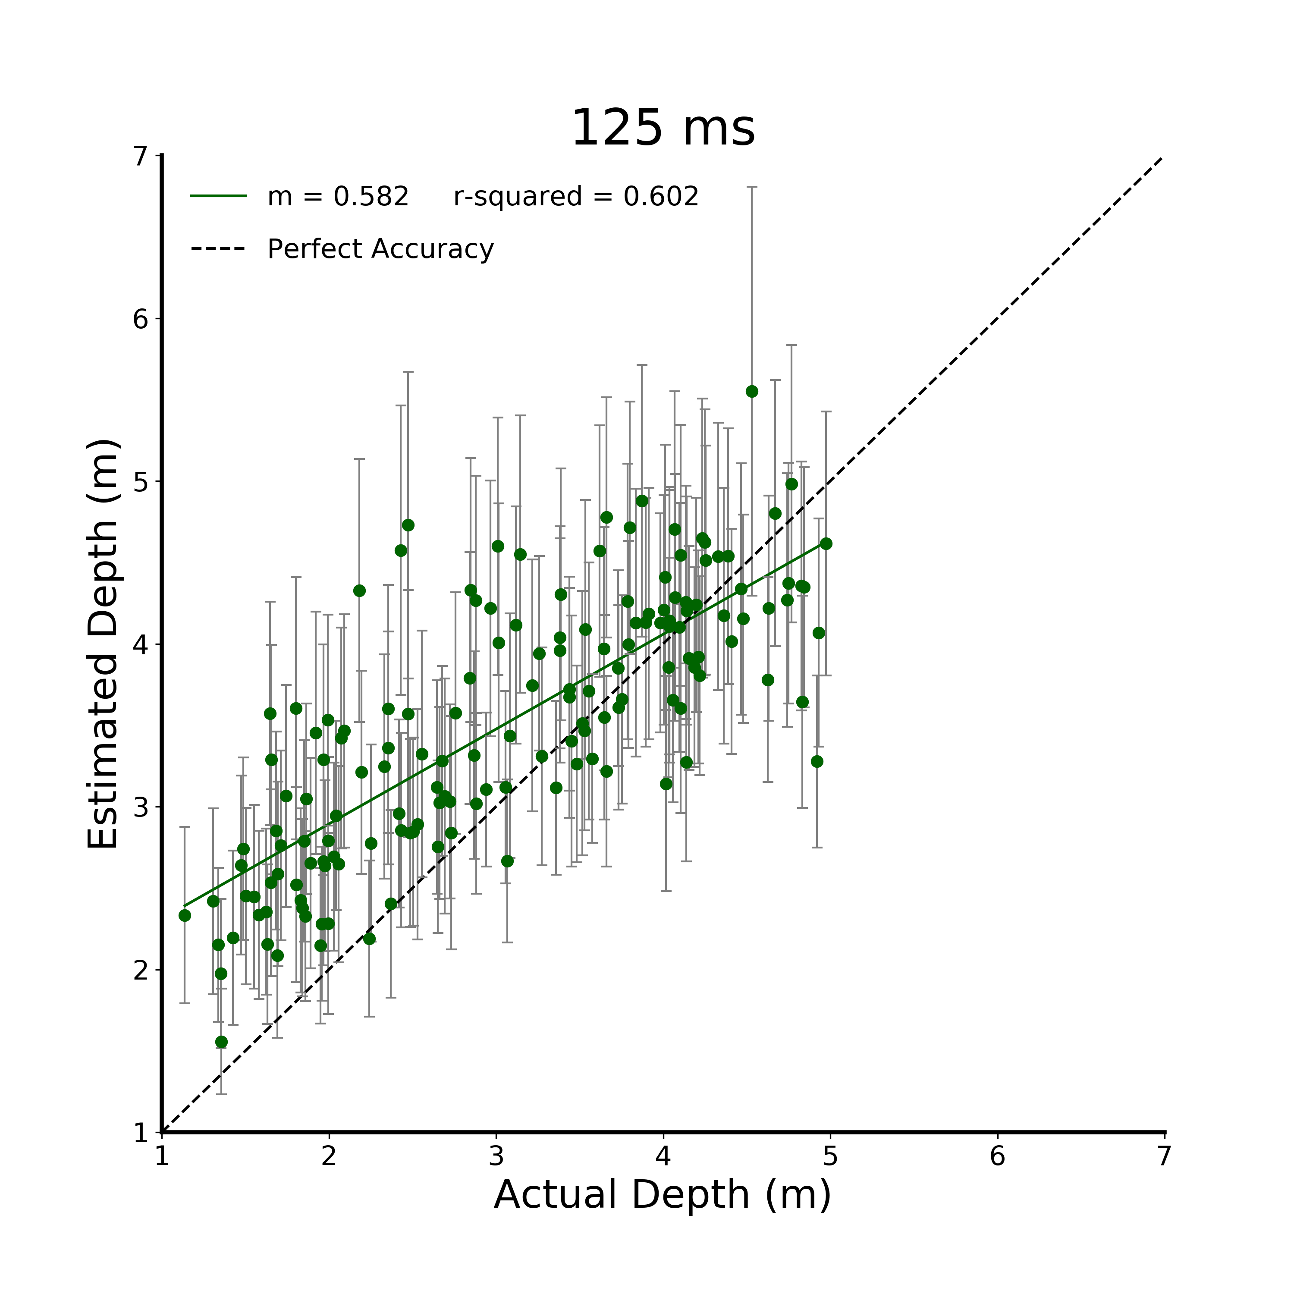
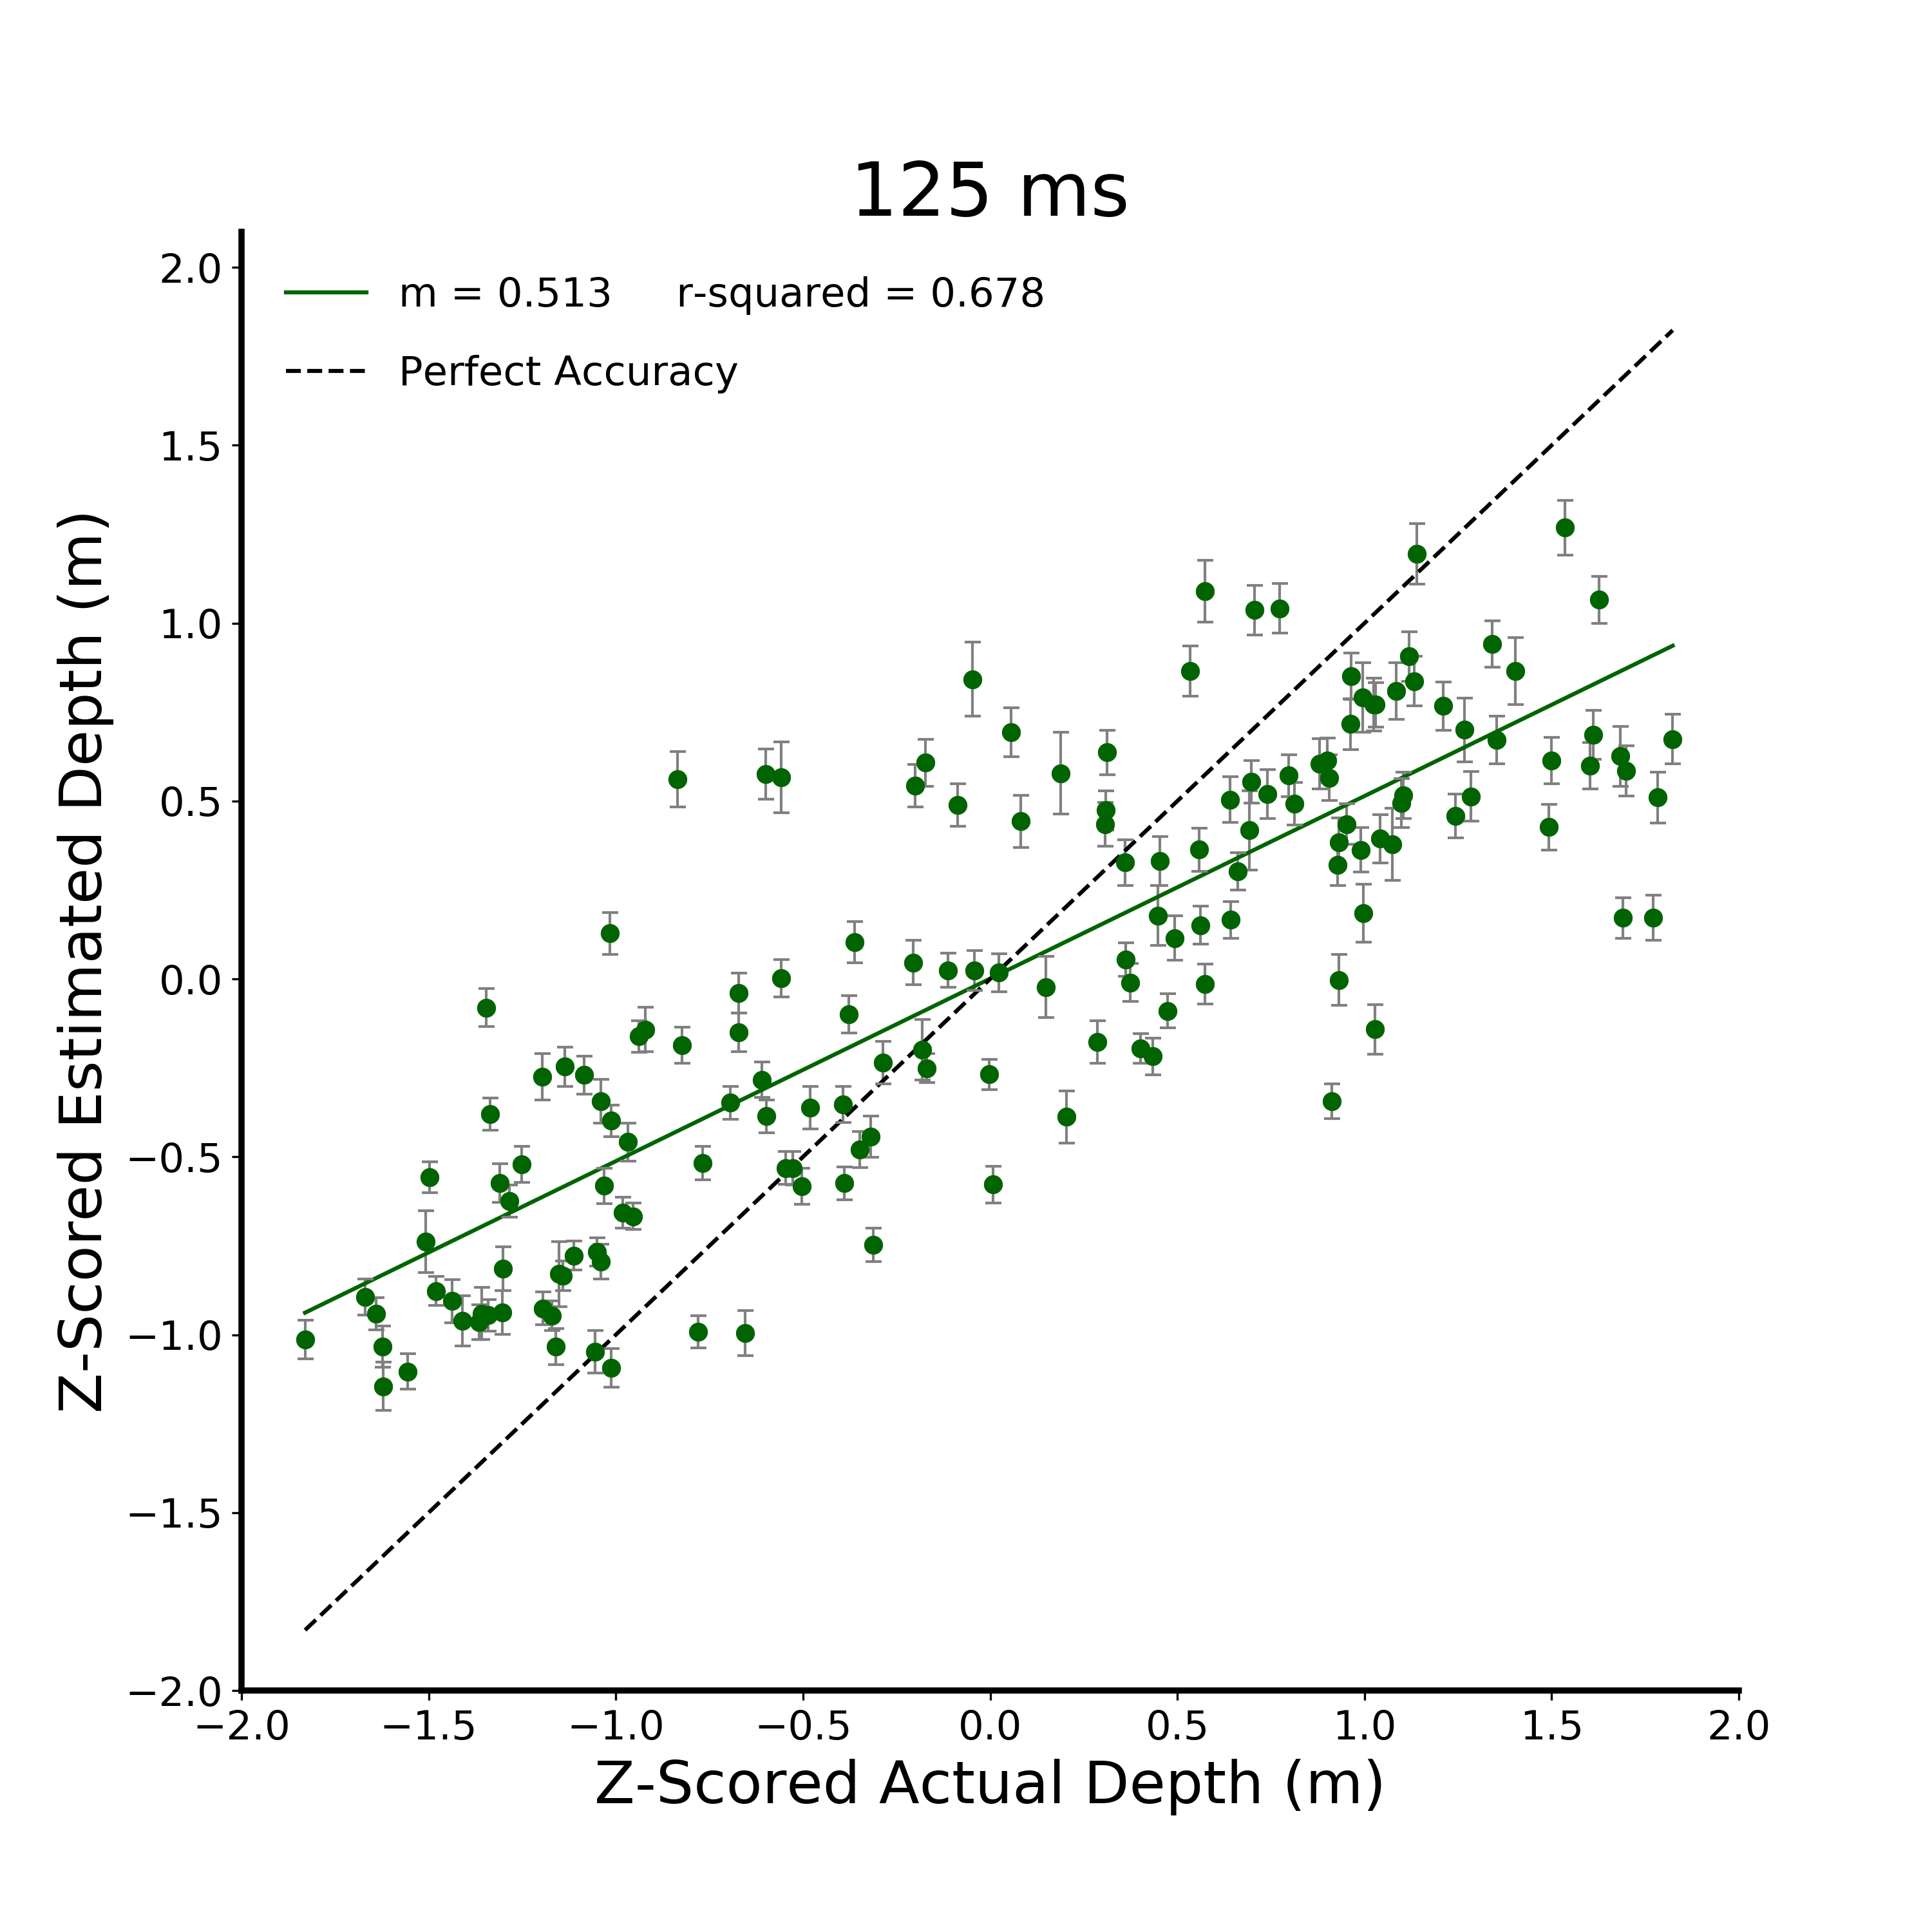
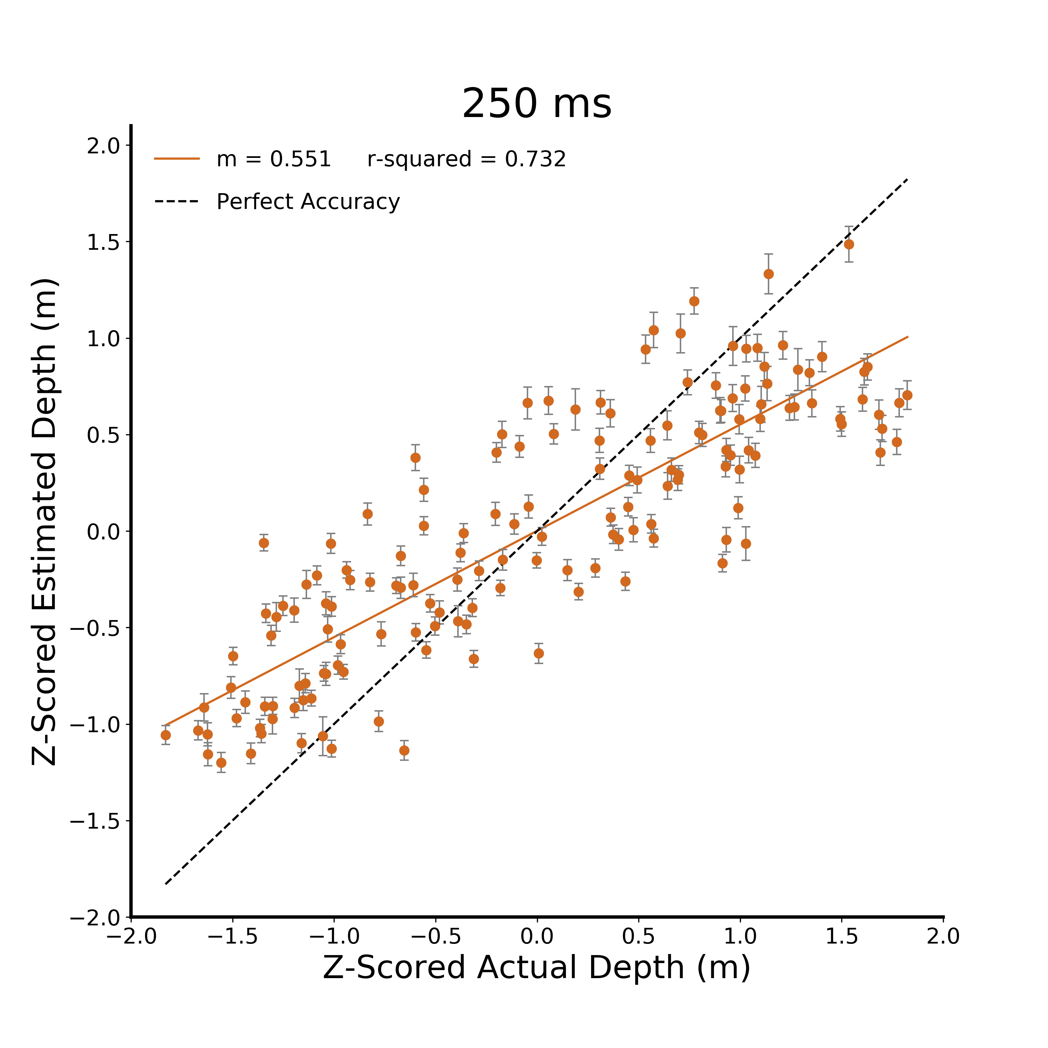
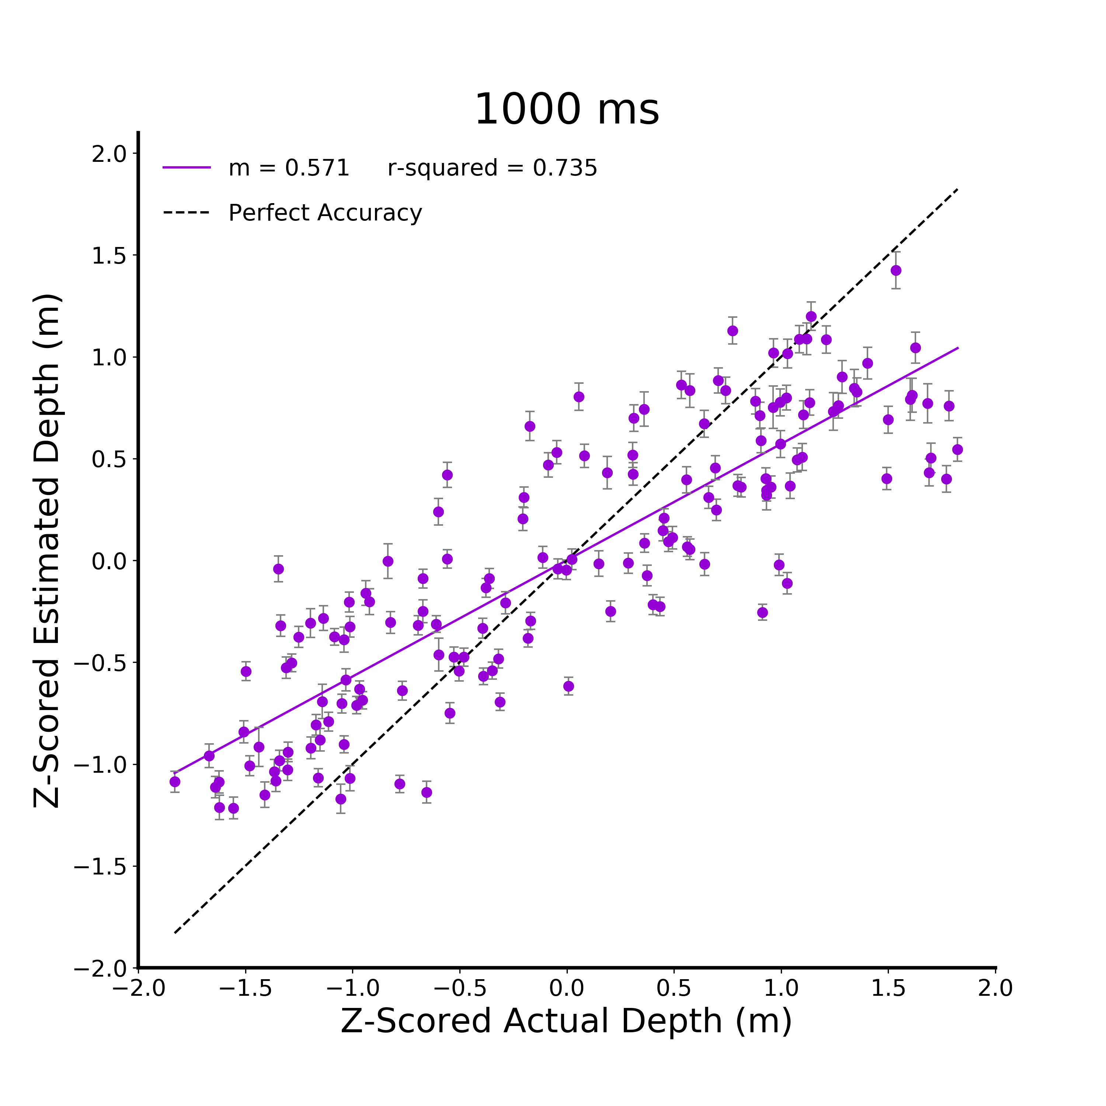
A.
B.
C.
D.
Figure 2. Verbal Estimate Linear Models. A) Raw data from the verbal estimate task for the 125 ms viewing duration condition. Participants are independent between viewing duration conditions and all error bars in plots are between subjects standard error. B) Z-scored data at 125 ms. C) Z-scored data at 250 ms. D) Z-scored data at 1000 ms.

Slide 3
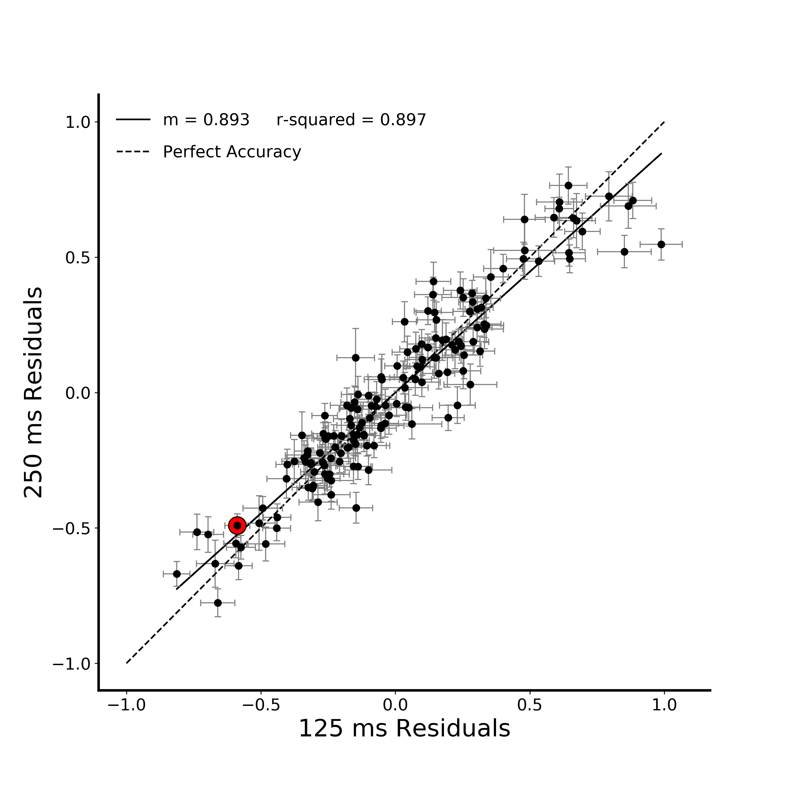
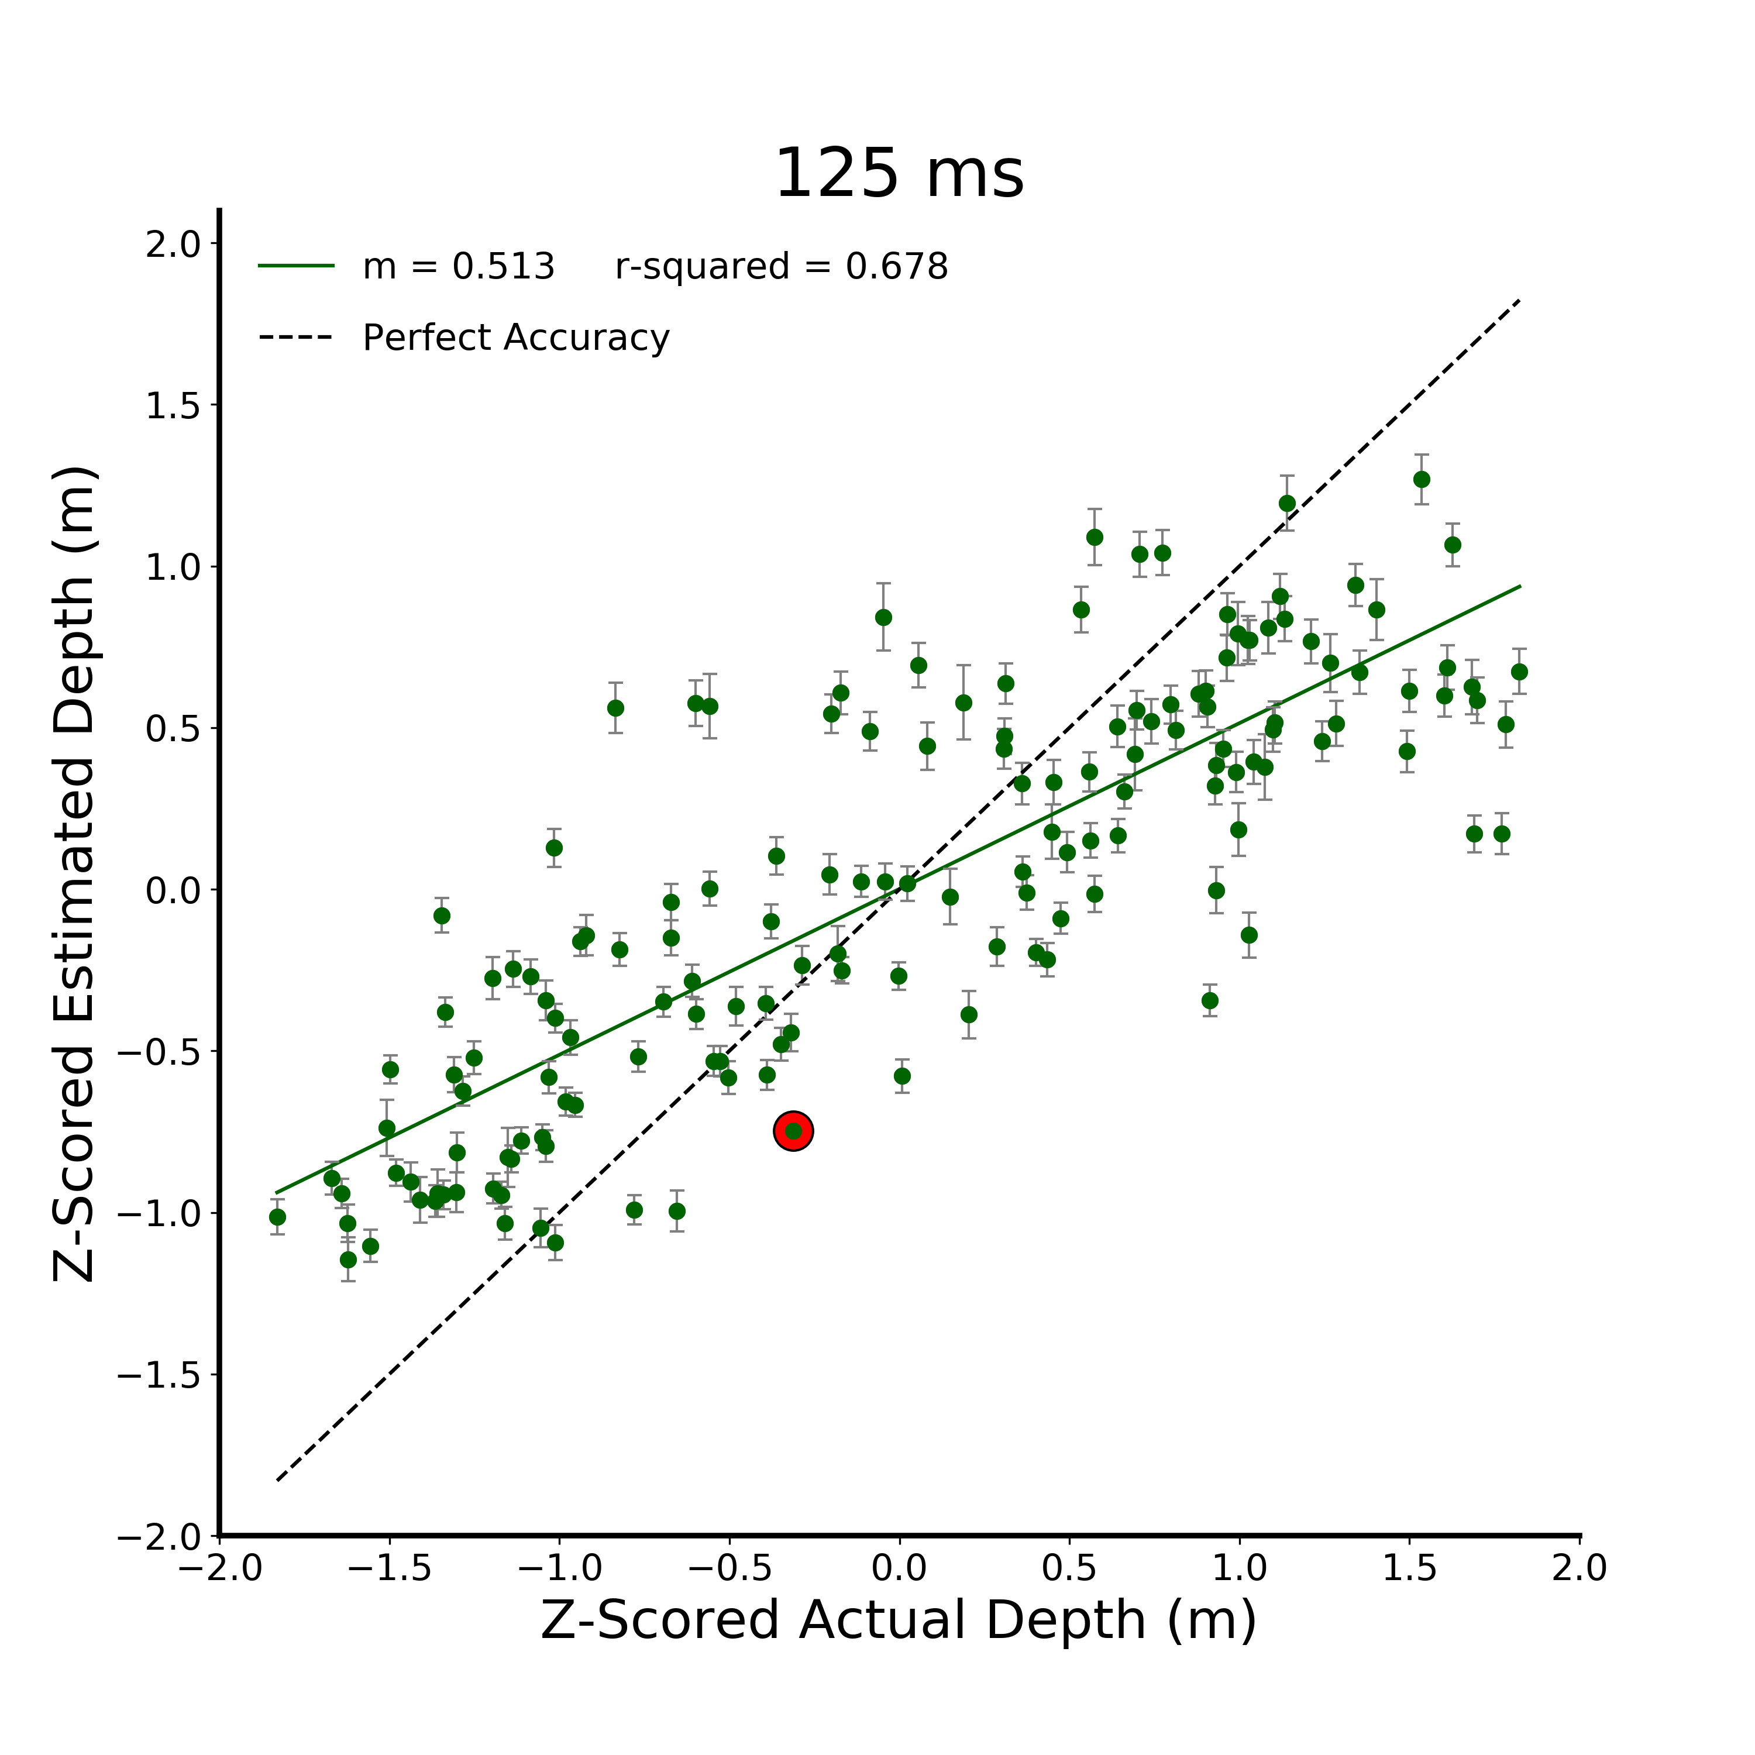
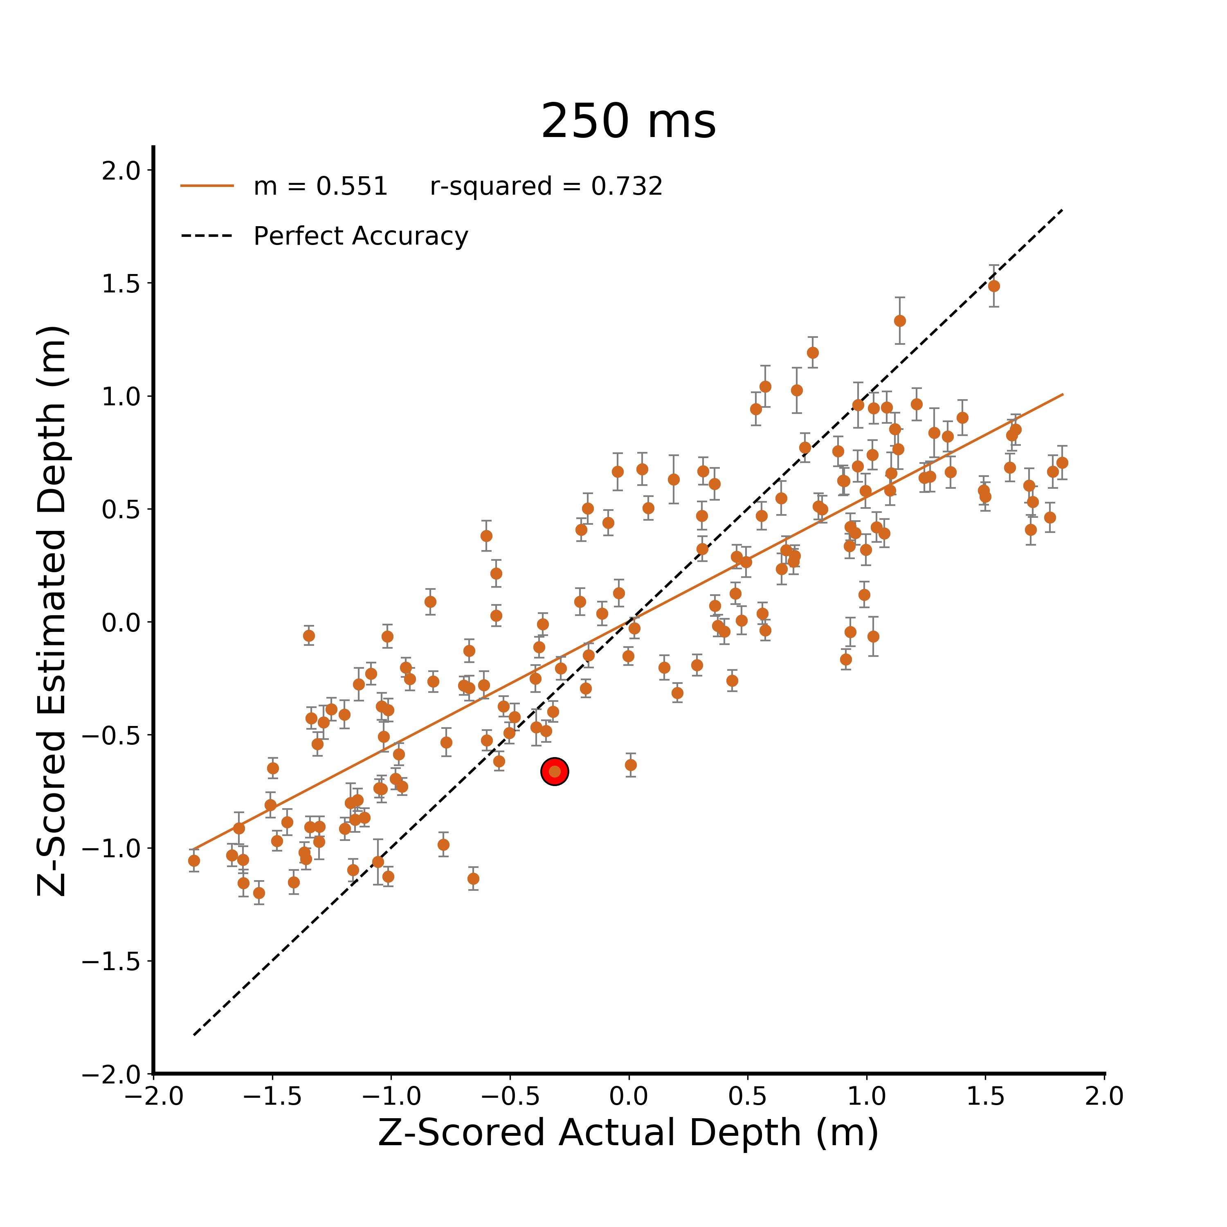
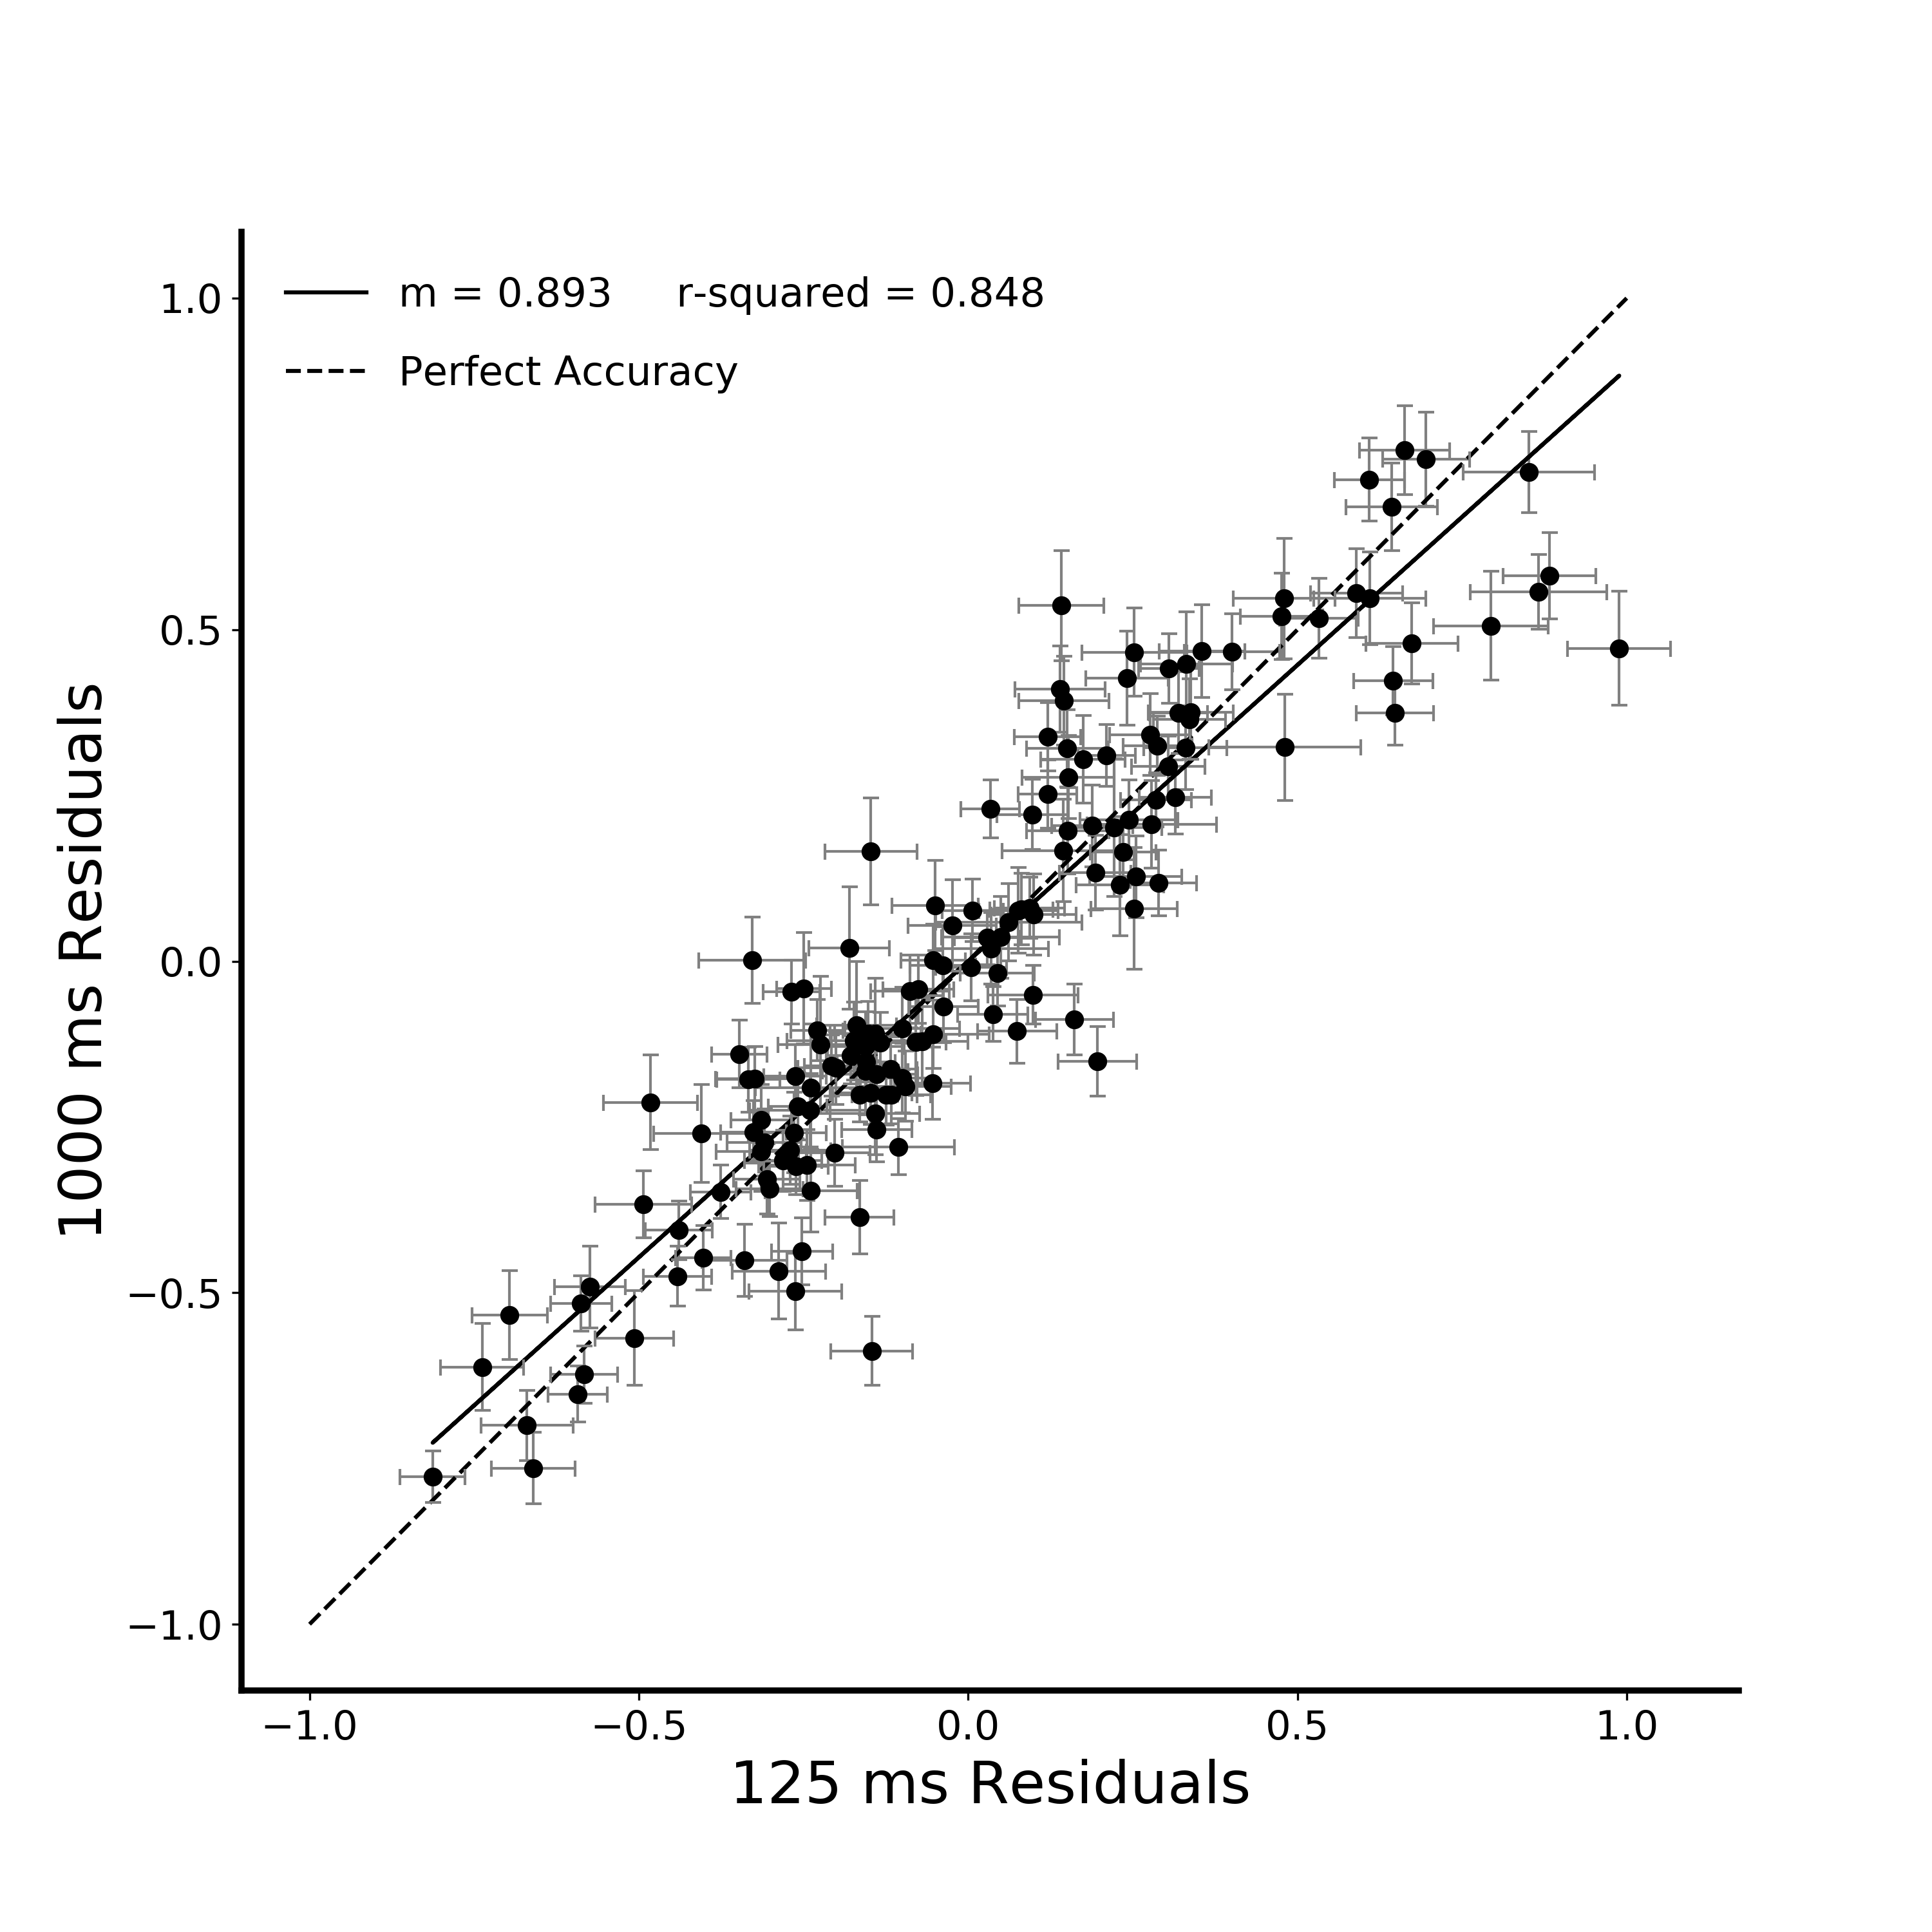
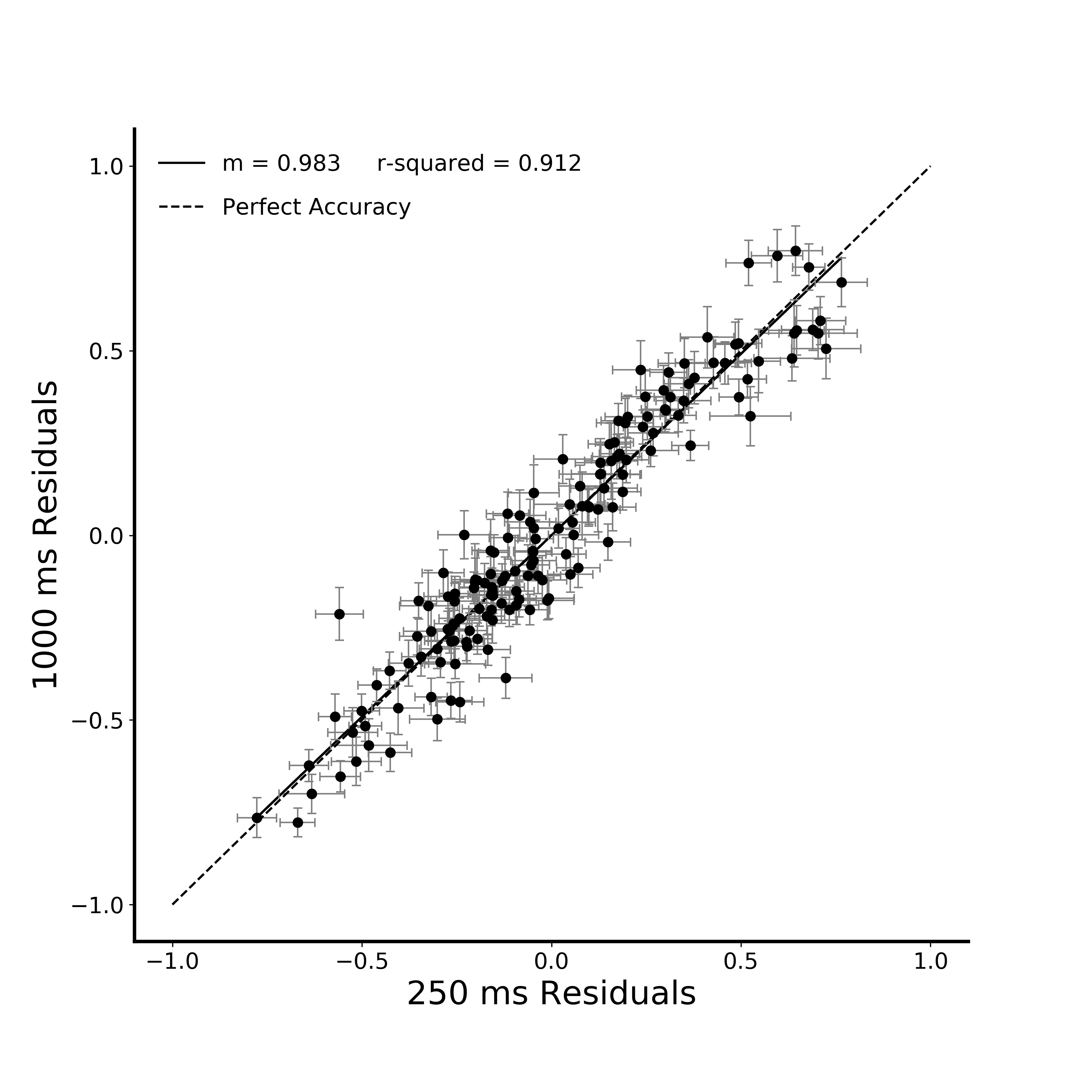
A.
B.
C.
D.
Figure 3. Correlation between verbal estimate regression residuals in Figure 2. A) Raw data from the verbal estimate task for the 125 ms viewing duration condition. Participants are independent between viewing duration conditions and all error bars in plots are between subjects standard error. B) Z-scored data at 125 ms C) Z-scored data at 250 ms D) Z-scored data at 1000 ms

